Slide 1


Institute of Advanced Research
Department of Computer Science and Engineering
OGANI - E-commerce Website
Mentor : Dr. Pankti Bhatt
Smeet Patel (IAR/12399)

Slide 2


WHERE PURITY MEETS PURPOSE

Slide 3

Introduction
OGANI is an e-commerce platform designed for seamless online shopping.
Built using Django, it provides a user-friendly shopping experience.
Features include product browsing, filtering, cart management, checkout, and secure payments.
Admin dashboard for managing products, orders, and users.

Slide 4



Problem Statement
Customers struggle with inefficient and outdated online shopping platforms.
Lack of seamless product filtering and checkout processes.
Admins face difficulty in managing products and orders efficiently.

Slide 5



Solution
OGANI provides an easy-to-use, modern e-commerce solution.
Features such as AJAX-based product filtering and a robust cart system enhance user experience.
The admin panel allows smooth management of products and orders.

Slide 6




Tech Stack Used
Frontend
Backend
Database
Other Tools
HTML/CSS
Python
MySQL
PlantUML
JavaScript
Django Framework
PostgreSQL
jQuery
AJAX
REST APIs
Bootstrap

Slide 7
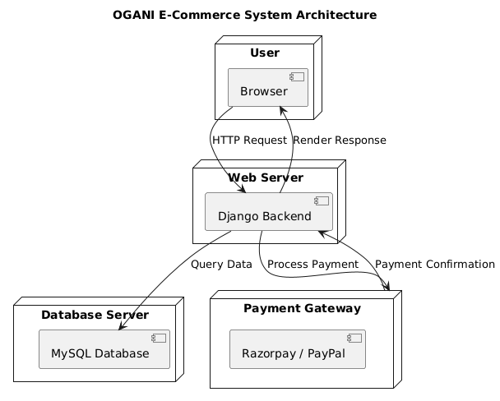
System Architectures
The system follows an MVC (Model-View-Controller) architecture.
Frontend (Views): Manages UI and user interactions.
Backend (Models & Views): This handles data processing and business logic.

Slide 8
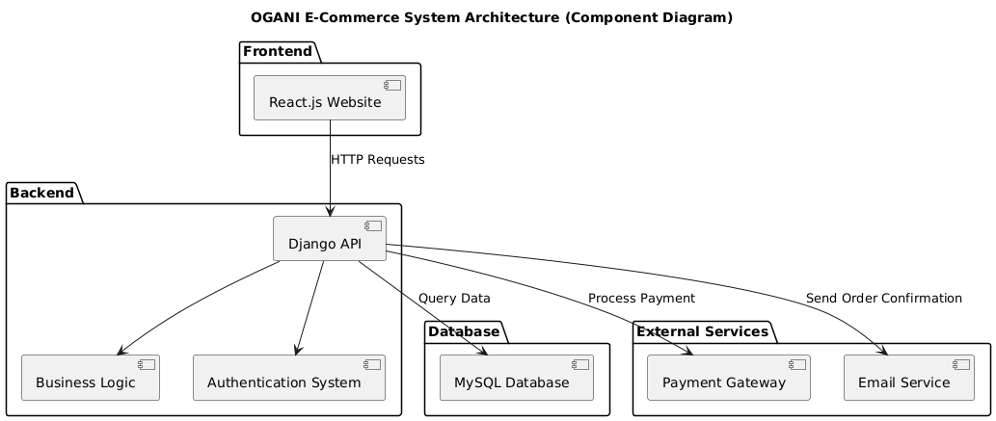
System Architectures
Database: Stores products, users, orders, and transactions.
APIs: These are for secure communication between the front end and back end.

Slide 9
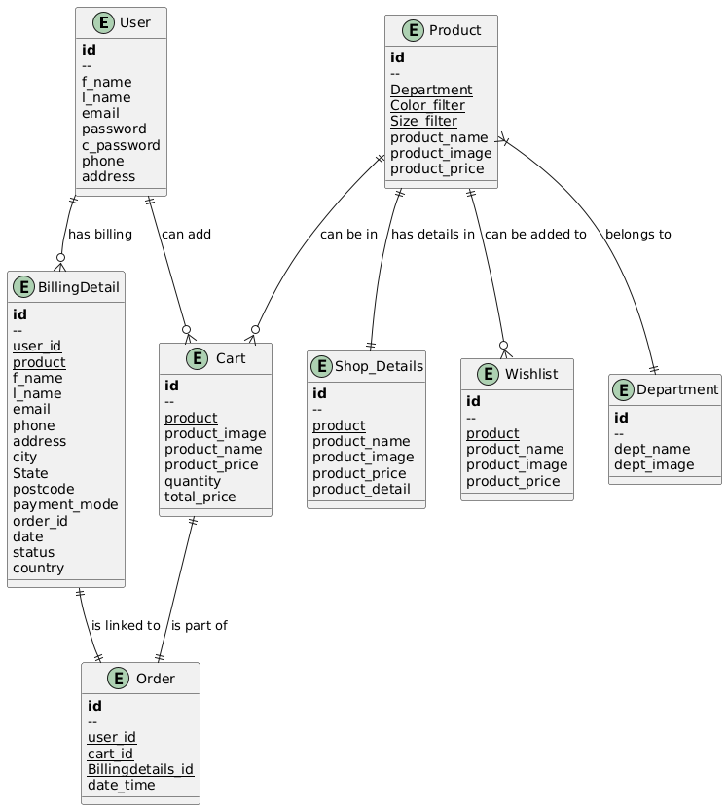
ER Diagram

Slide 10
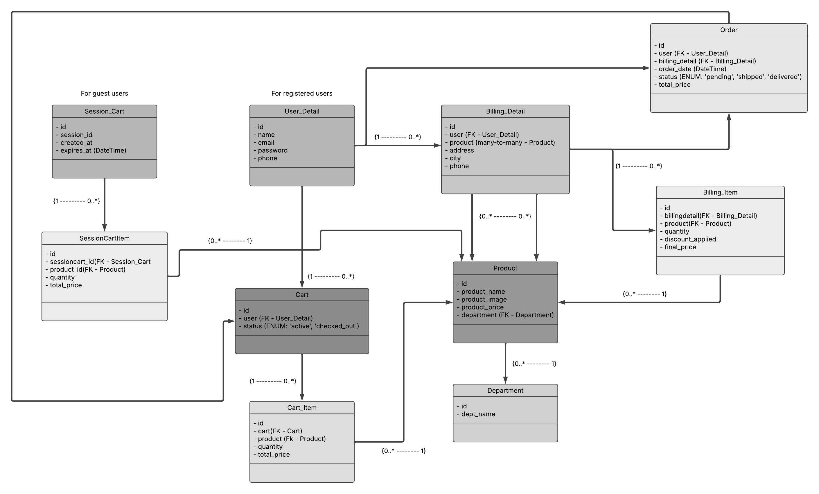
Class Diagram

Slide 11
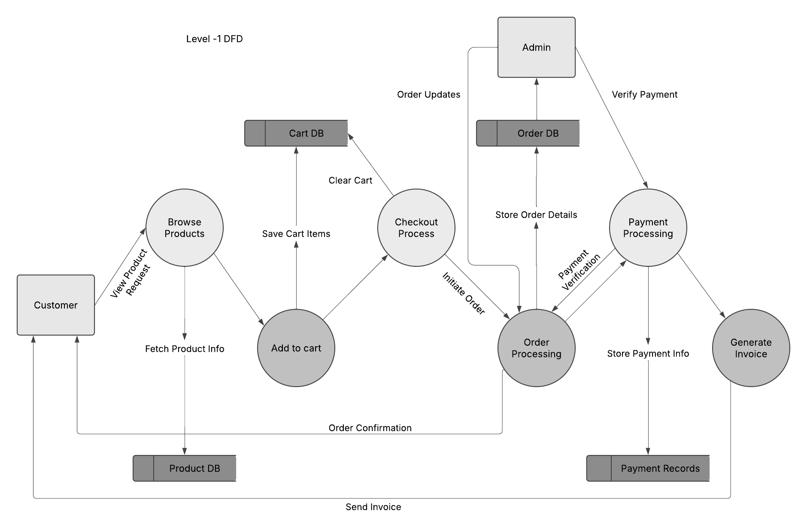
Data Flow Diagrams
DFD Level -1

Slide 12
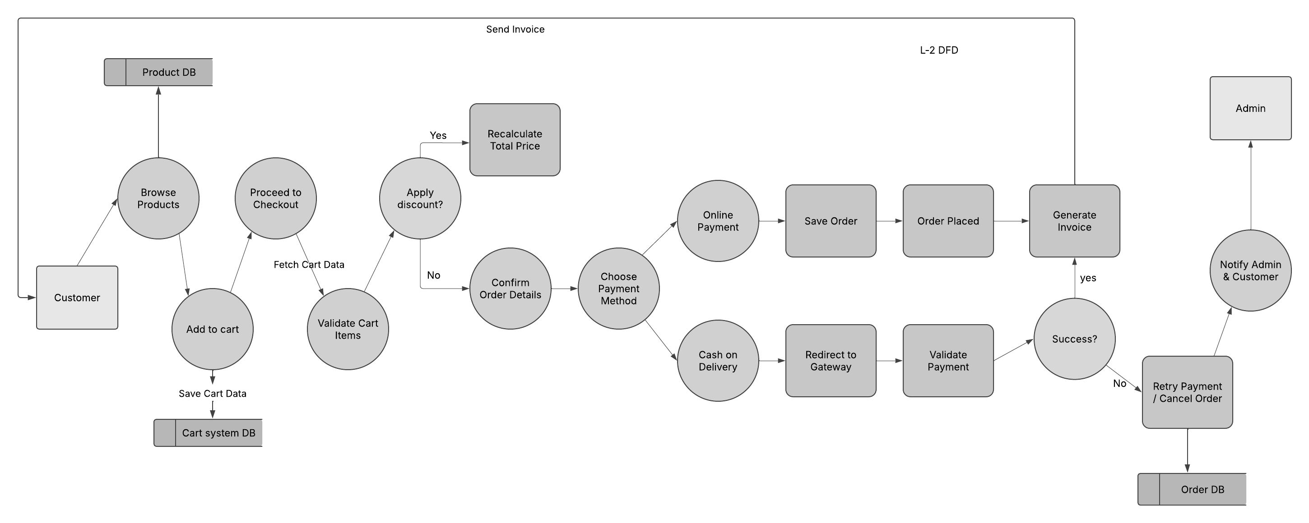
Data Flow Diagrams
DFD Level -2

Slide 13
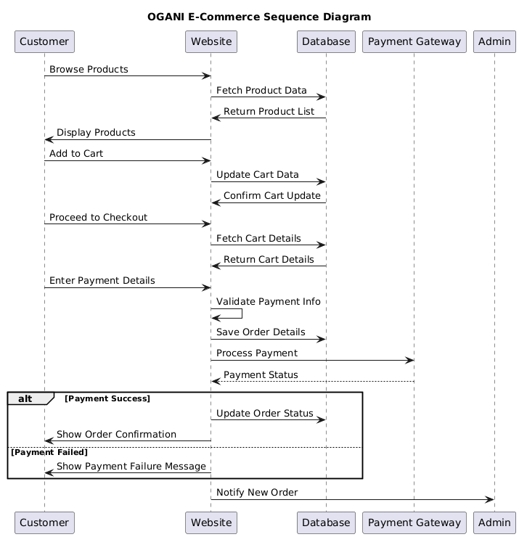
Sequence Diagram

Slide 14
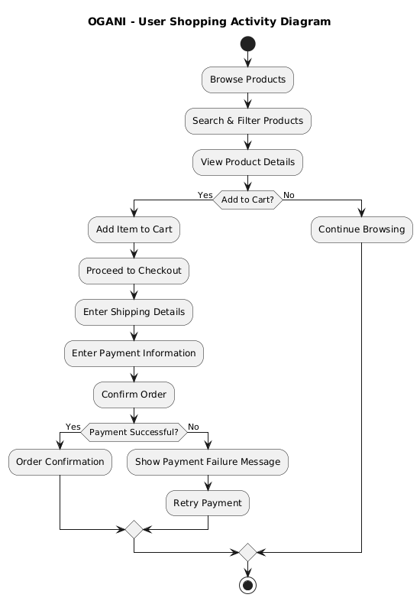
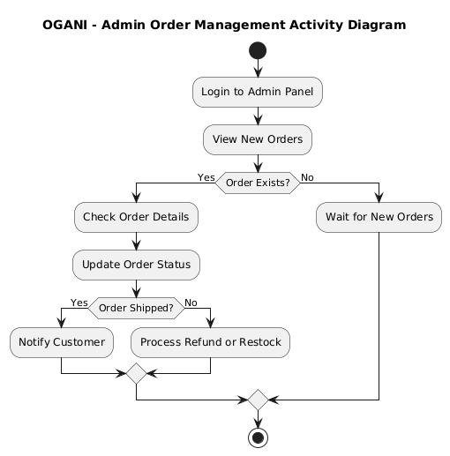
Activity Diagram

Slide 15
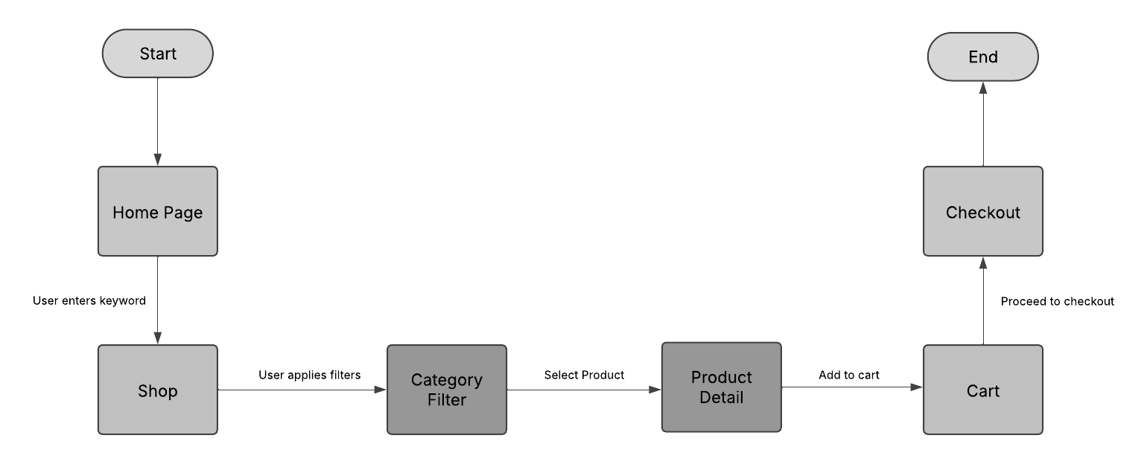

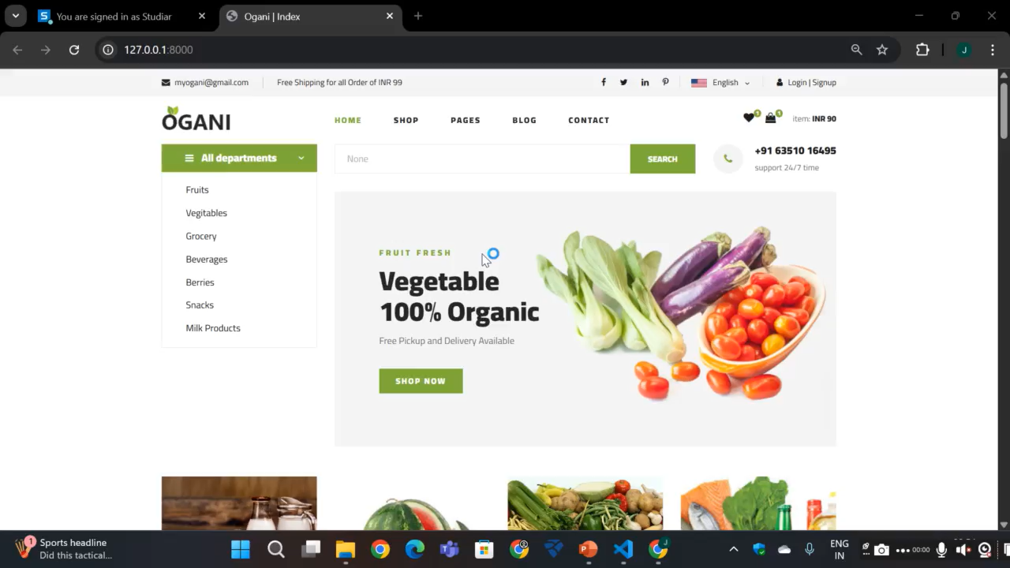
Front end logic flow

Slide 16
Front end logic flow (Preview)

Slide 17
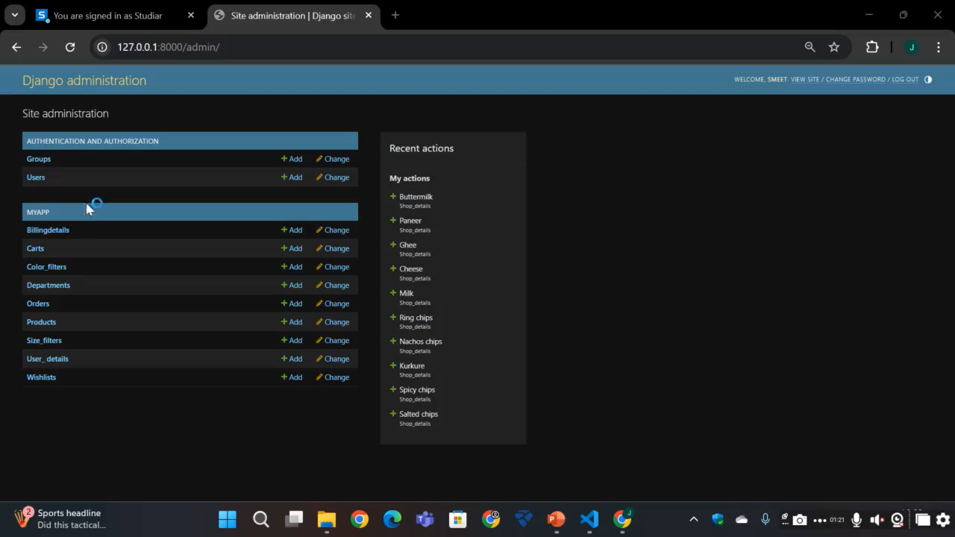
Front-end logic flow (Admin Panel Preview)

Slide 18
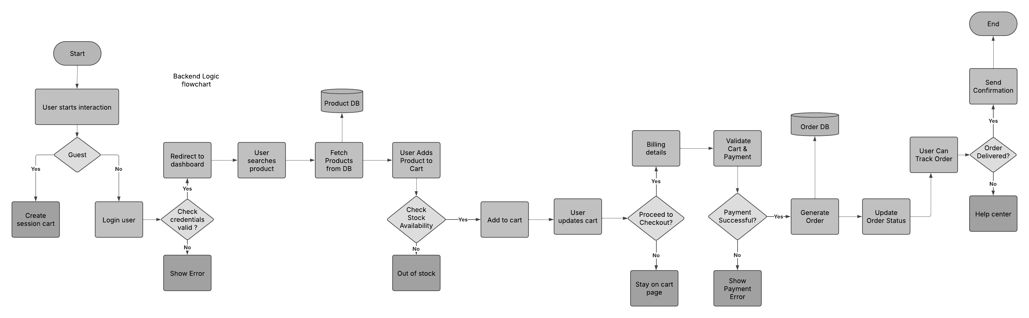
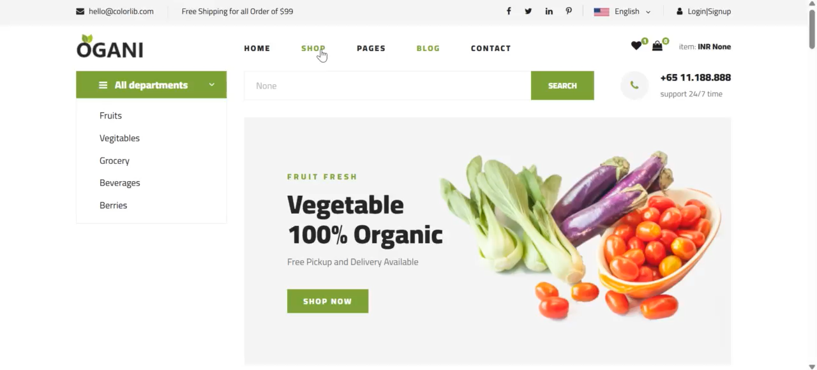
Back end logic flow

Slide 19
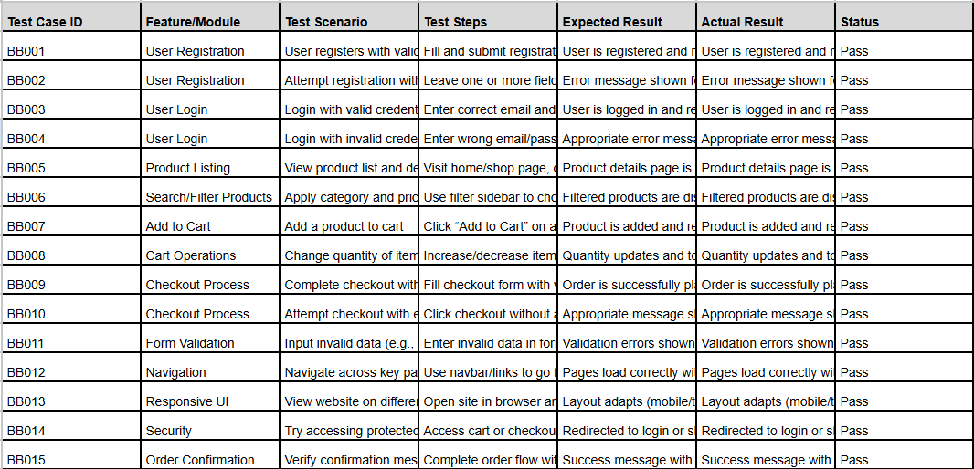
Test Case ( Black-Box test cases)

Slide 20
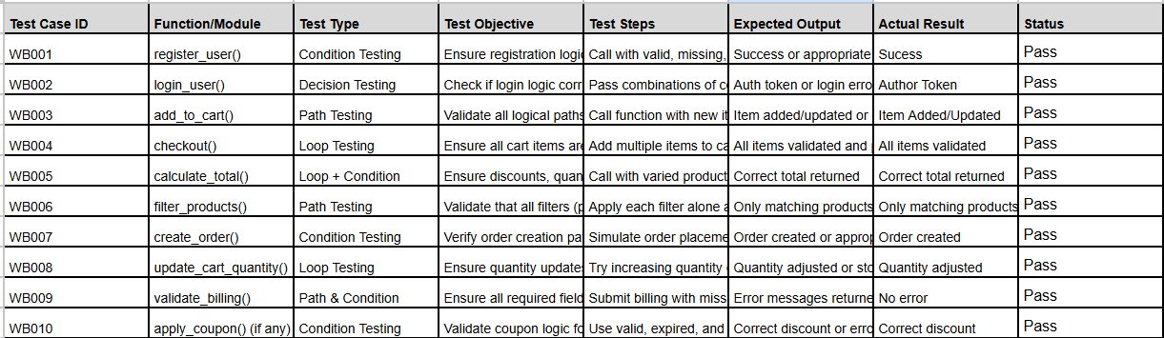
Test Case (White-Box test cases)

Slide 21
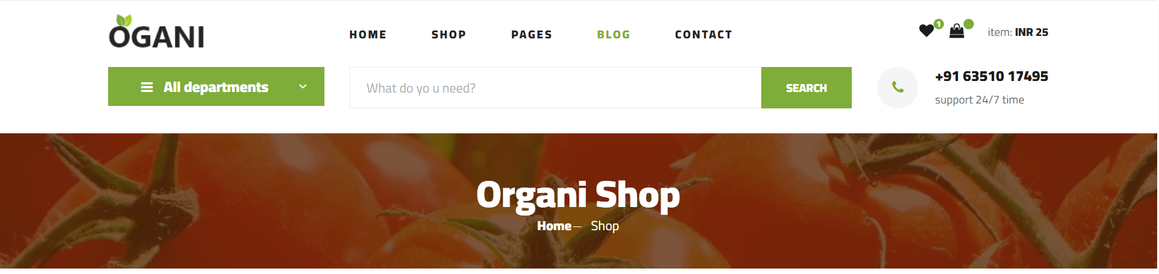
Features & Functionalities
Product Browsing & Filtering (AJAX-based for smooth experience).
User Registration & Authentication (Login, Logout, Secure Access)
Cart & Checkout System (Seamless shopping experience)
Admin Panel (Manage products, orders, payments)
Secure Payments (Integration with Payment Gateway)
Order Tracking & Management (For both users and admins)

Slide 22

Conclusion
OGANI provides a modern, efficient, and user-friendly e-commerce experience. Django-powered backend ensures scalability and security. The admin panel enhances business operations & product management.

Slide 23
Future Enhancements
AI-based product recommendations.
Advanced search & filtering with ML.
Multi-vendor marketplace integration.
Mobile app version for a better shopping experience.

